Slide 1
BIOL 528: Final Project

Slide 2
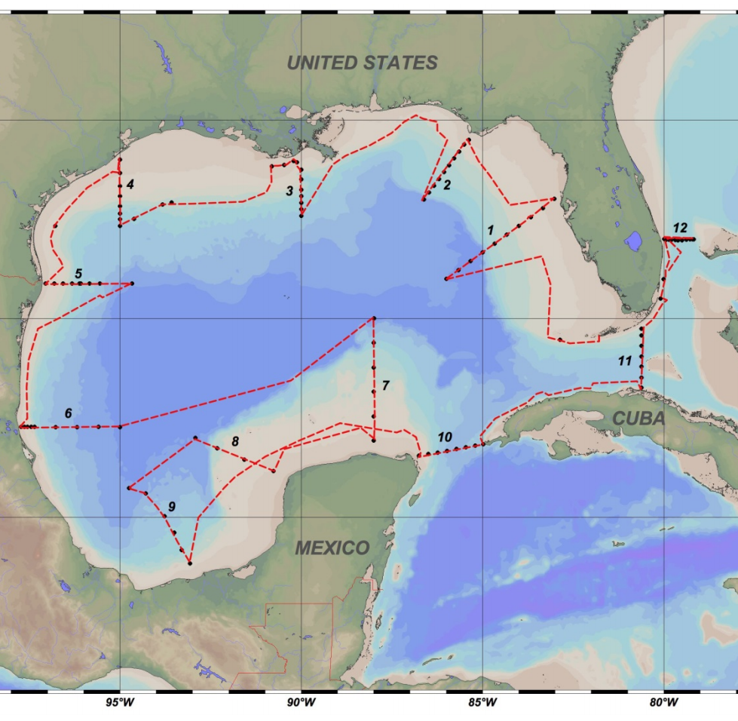
Data
The data used was from the third Gulf of Mexico Ecosystems and Carbon Cruise (GOMECC-3)

Slide 3
After processing in R:
Clipped the larger shapefile to just the Gulf of Mexico using a rectangle
Create a point file using the coordinates from the data

Slide 4
Interpolated the surface pCO₂ using Bayesian Kriging to predict the pCO₂ trends within the Gulf of Mexico.
Higher pCO₂ areas include:
Mississippi Delta
Northern Yucatan
East Texas coast
Western Florida coast
Lower pCO₂ areas include:
Southern Florida
Western Cuba

Slide 5
Acquired netCDF data of cholorphyl-a concentrations from October 2017 from Ocean Color Web and clipped
Reclassified to get better contrast with the higher chlorophyll-a areas
Calculated percent overlap at:

Slide 7
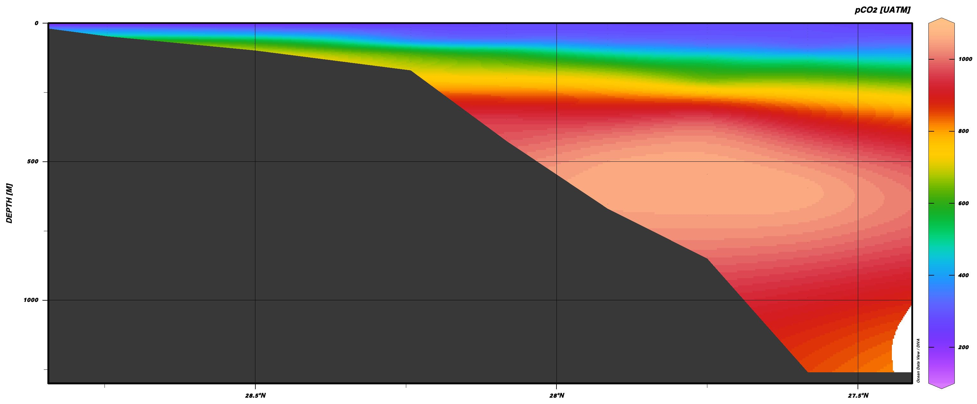
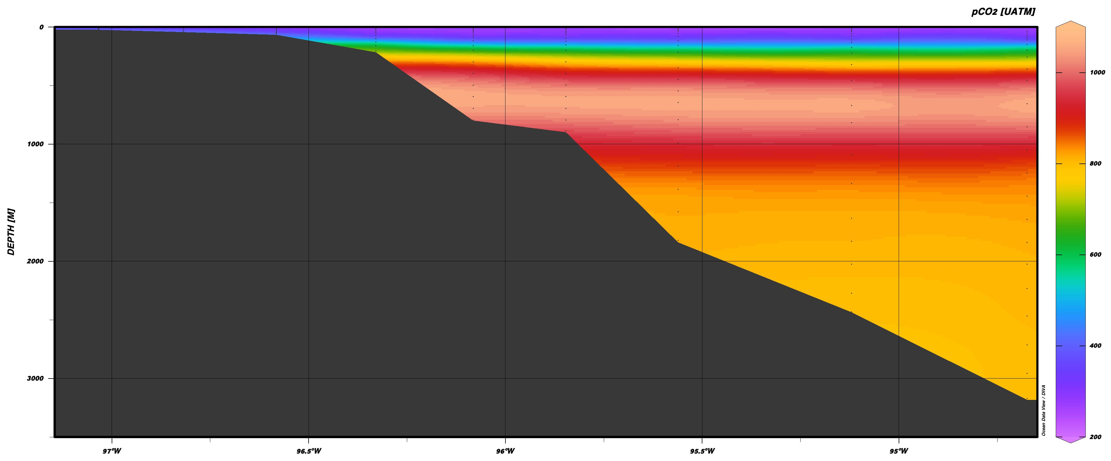
Louisiana
Galveston, TX

Slide 8
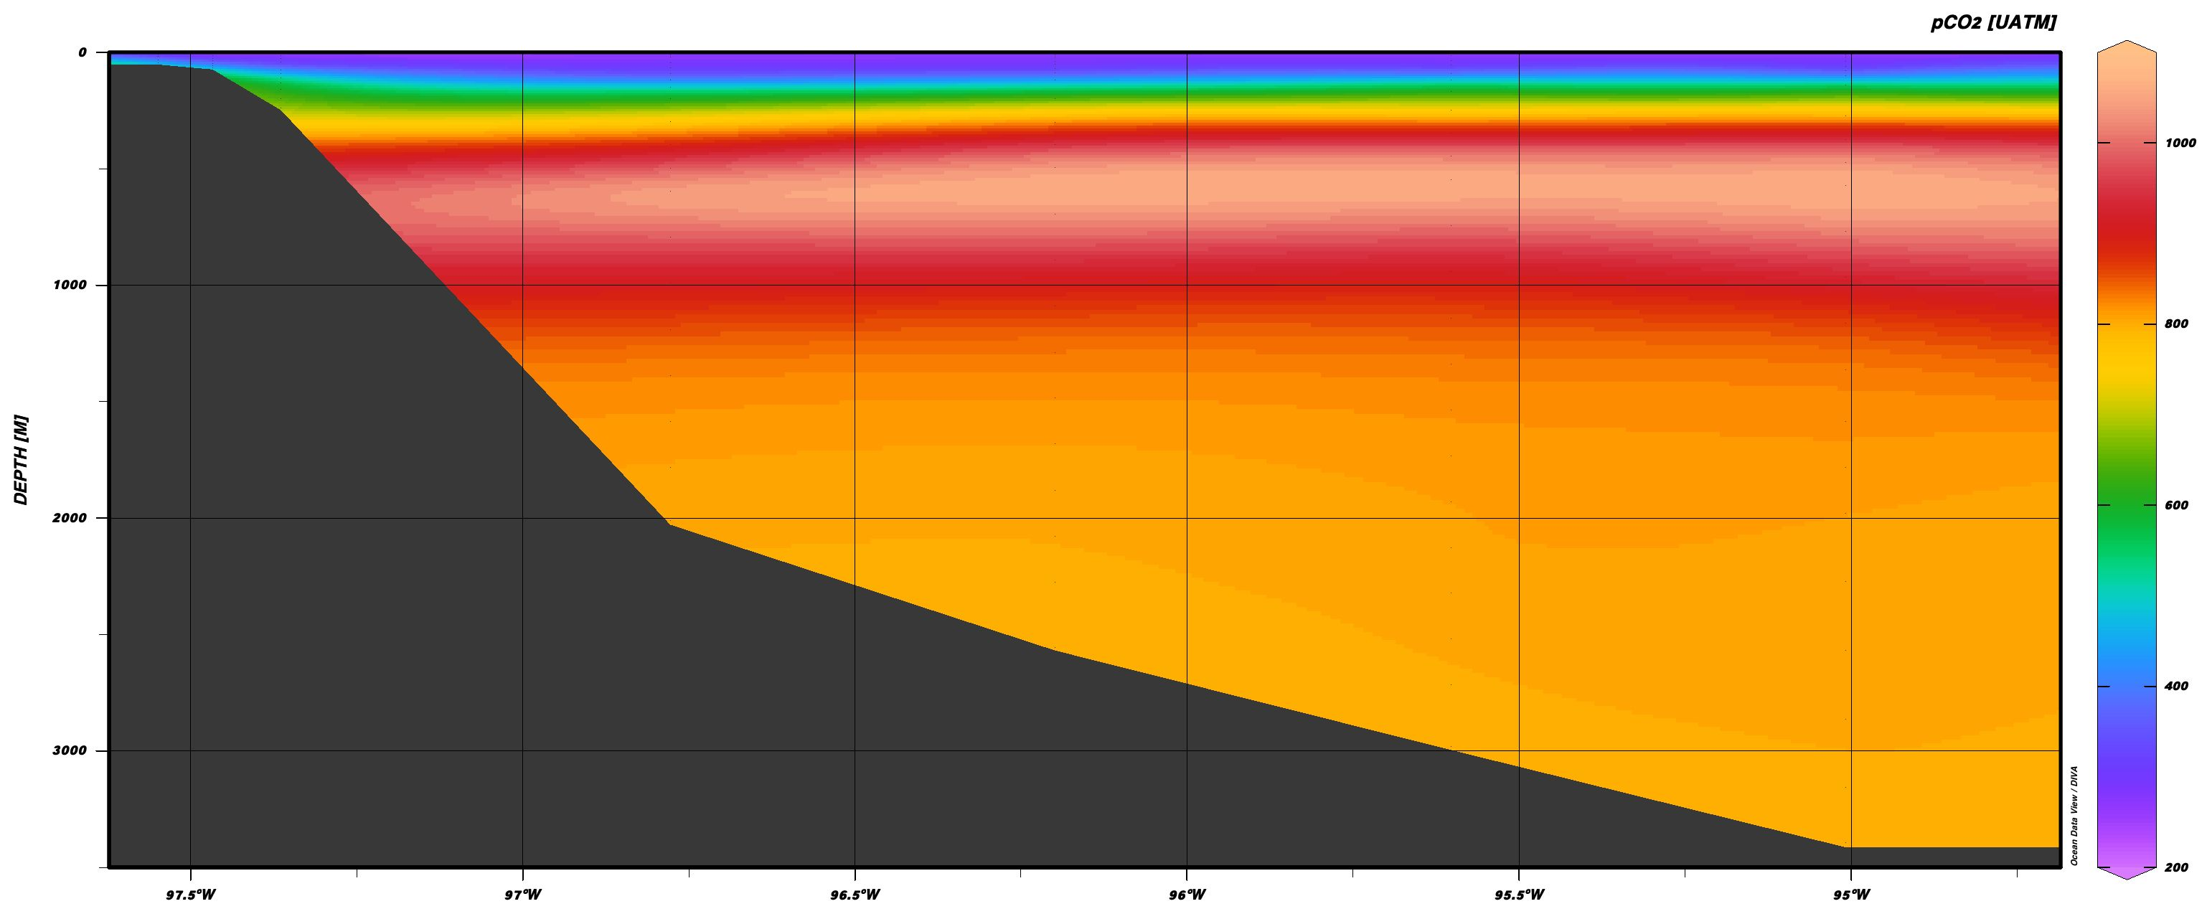
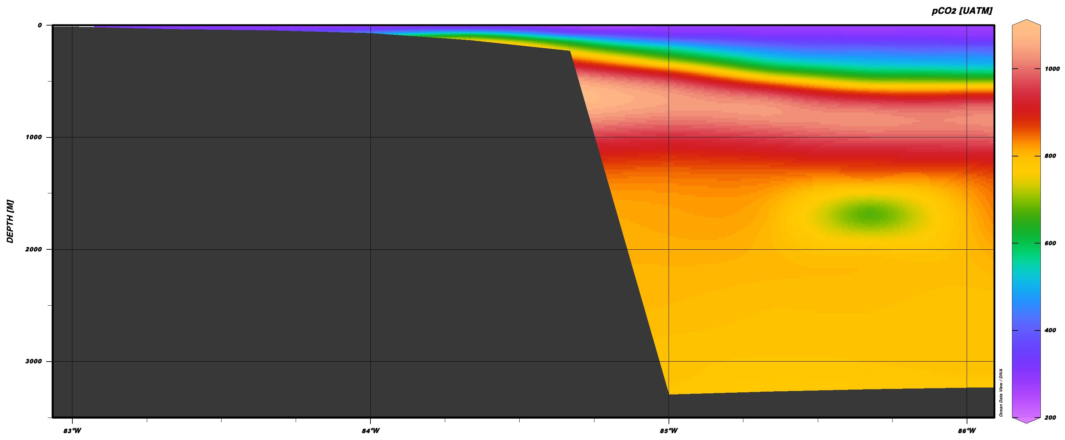
Brownsville, TX
Tampa, FL

Slide 9
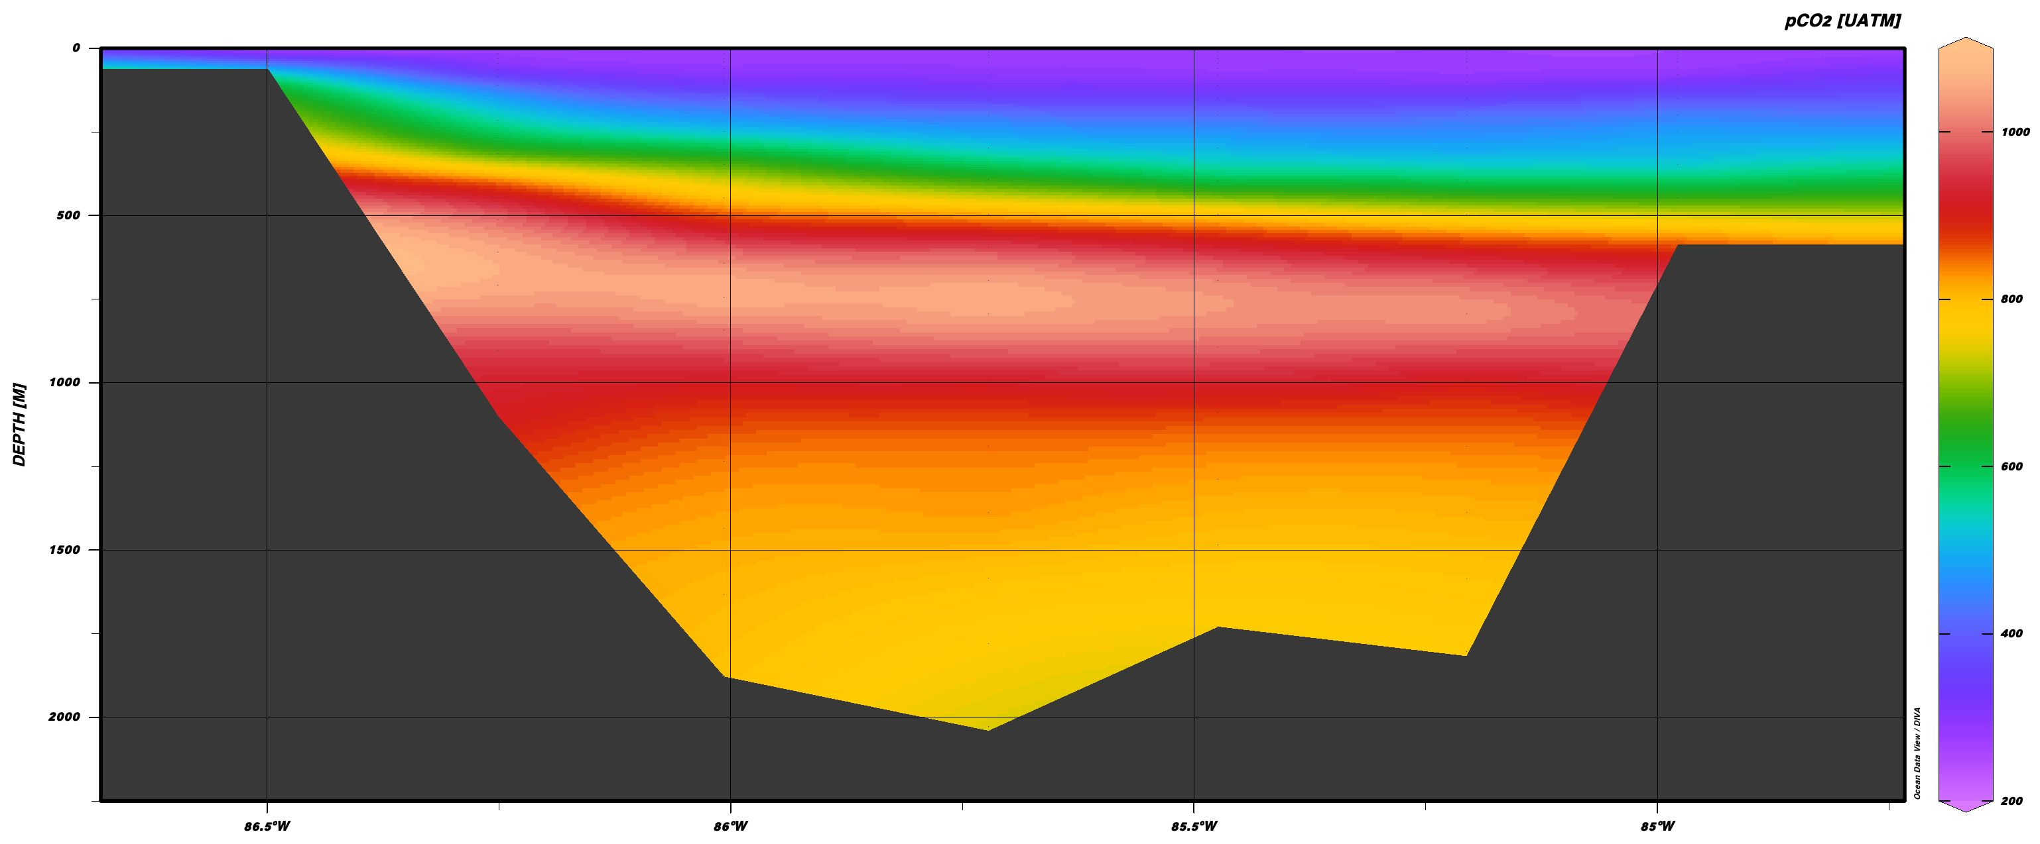
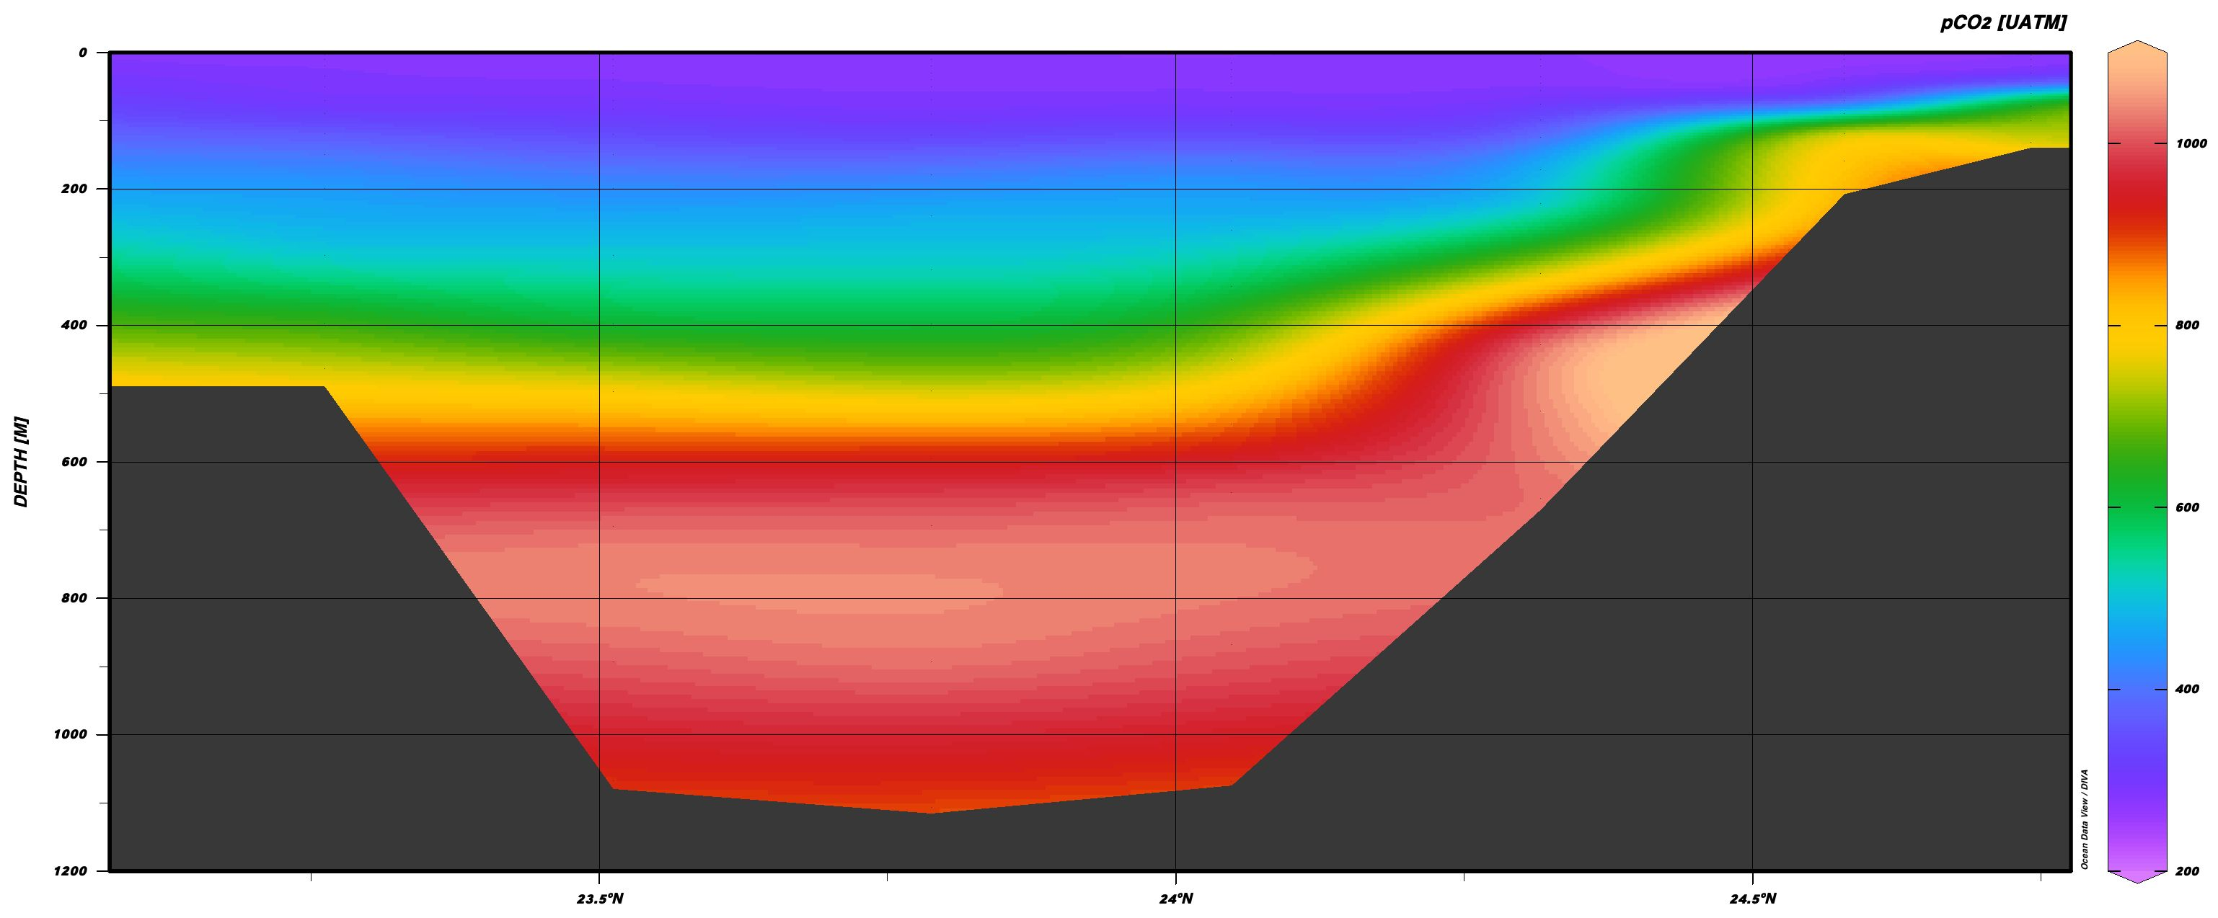
Yucatan Channel
Straits of Florida

Slide 10
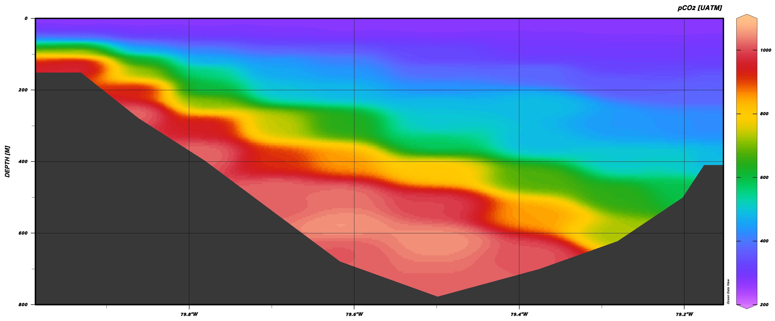
And just for Kelly – Miami/Fort Lauderdale

